Slide 1

Dusk of Mankind

Slide 2
01
02
Group Members :
03
04
Moin Uddin Huq
1620005042
Abdullahel Kafi
1620022042
Tanjila Islam Ritu
1811017642
Tanzila Islam
1811027042

Slide 3
Game concept
Dusk on mankind is a game where the sole objective is to survive the wave of enemies that are attacking the player.

Slide 4
Game loop :
Start Screen
Player dies
Player Spawn
Next wave start
Zombie spawn
Kill all zombies
Wave Start

Slide 5

Story & Progression

Slide 6
Protagonist’s Story
Our protagonists name is ”Alex”. Alex is a 34 years old male from the USA. He was traveling to South East Asia Countries on vacation.
Suddenly, the zombie outbreak hit, he got stuck there since then. The only way to reach his family is to go to Ukraine and catch a plane from there to USA. Alex had some firearm training when he served in the military. Now, he is using his training to kill the zombies and making his way towards Ukraine to get a chance to reunite with his family again.

Slide 8
Map Location
Train Station
This is the starting location. This map is located in Bali. This is where the journey of Alex begins.
Outskirts of Afghanistan
In this map Alex is making his way towards Ukraine. This map is located in the border between Pakistan and Afghanistan.
Granitsa Ukraine
At the last leg of Alex’s Journey. Located in the border between Ukraine and Kazakhstan.

Slide 9
The game will progress in waves.
There are three levels
Progression
Objective is to kill all the zombies thus clearing all the waves
Every level contains four waves

Slide 10
01
02
03
Tech
Engine
Assets
Animation
This game is based on Unreal Engine 4. We are also using blueprints feature.
Our environtmental assets are from quixel bridge. We are using some from Epic Marketplace too.
We are using some animations from Epic marketplace but mostly from Adobe Mixamo.

Slide 11

Progress till Now

Slide 12
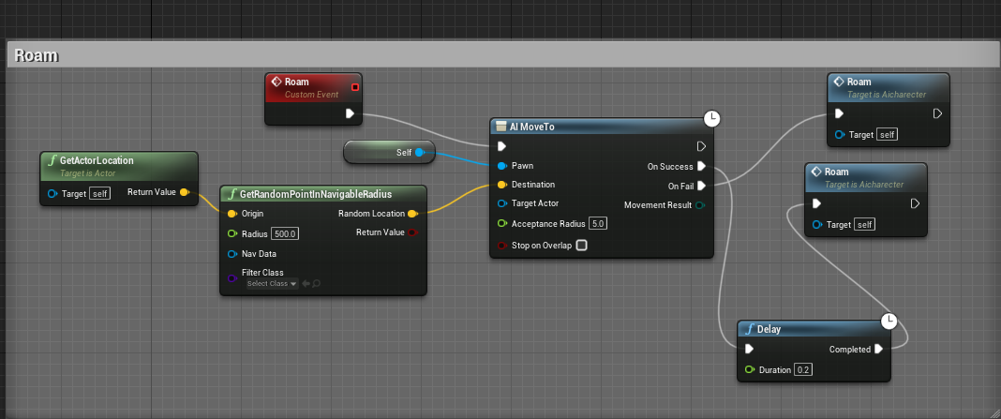
Enemy AI (Roaming)

Slide 13
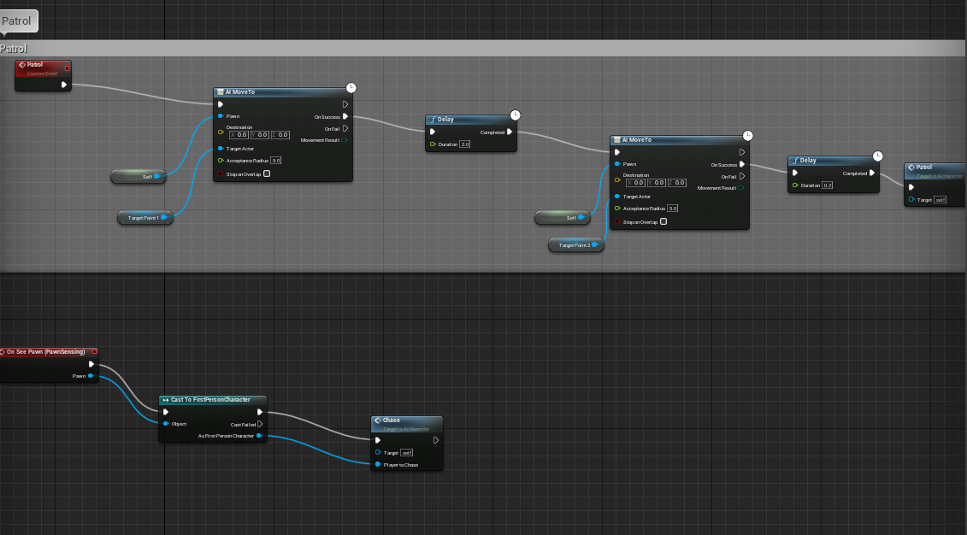
Enemy AI (Patrolling Perimeter)

Slide 14
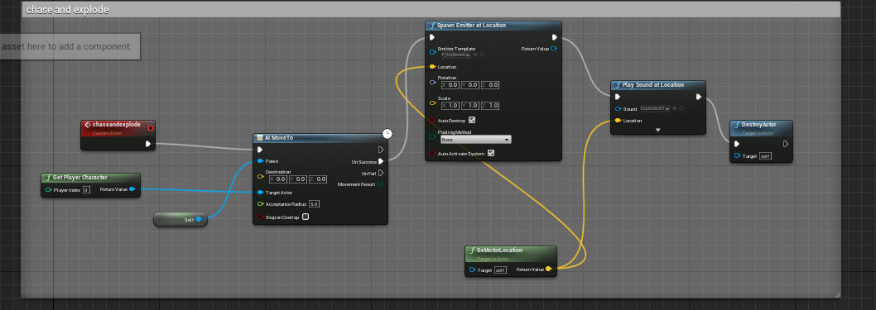
Enemy AI (Chase and Explode)

Slide 15
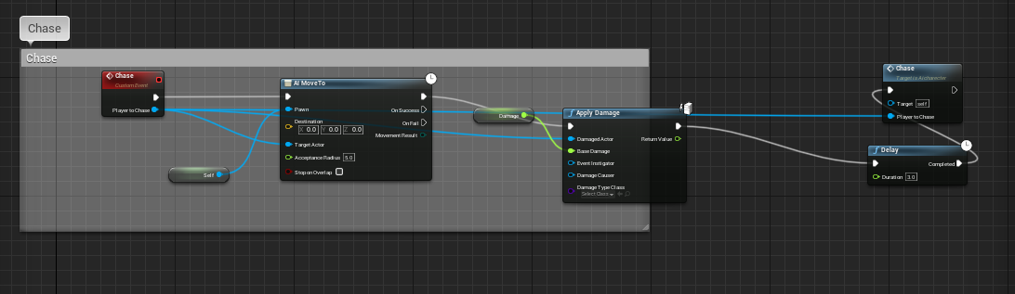
Enemy AI (Chase and Follow)

Slide 16
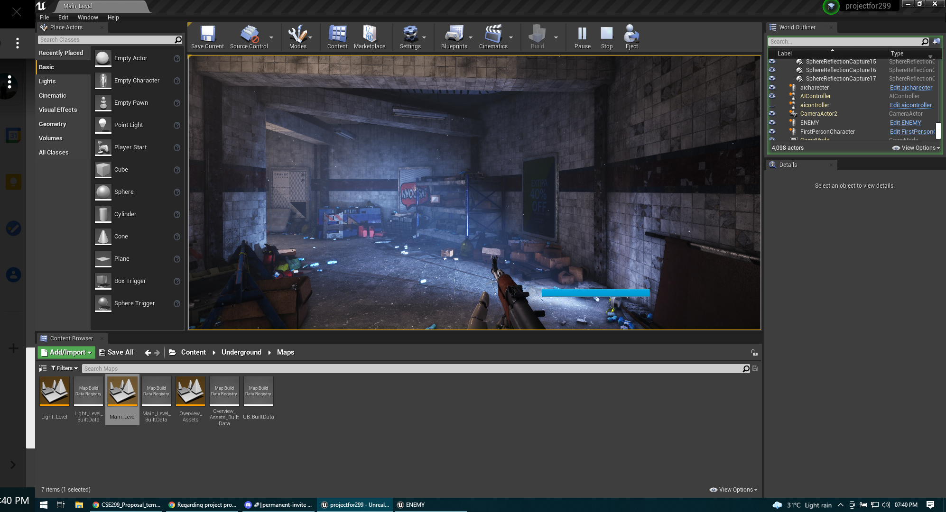
Train Station Level (WIP)

Slide 17
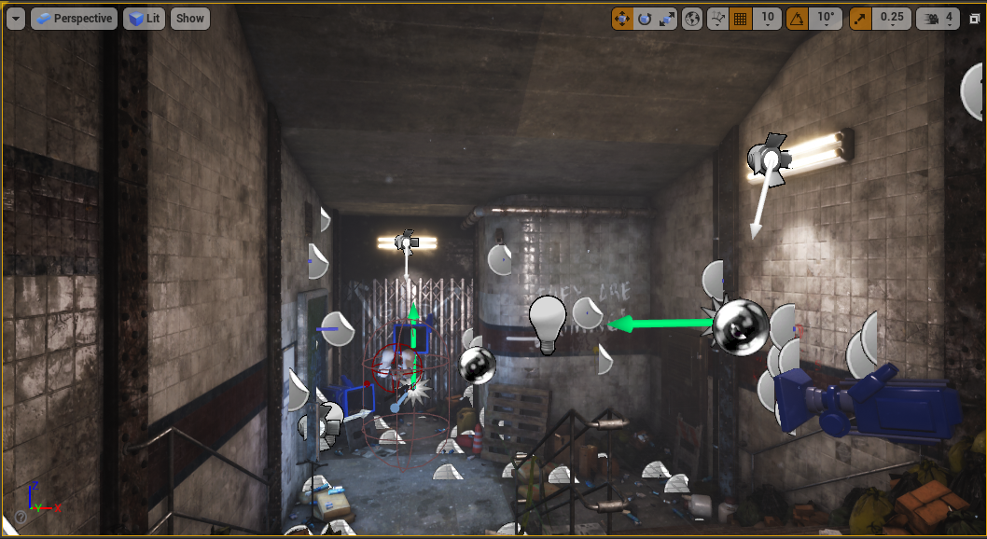
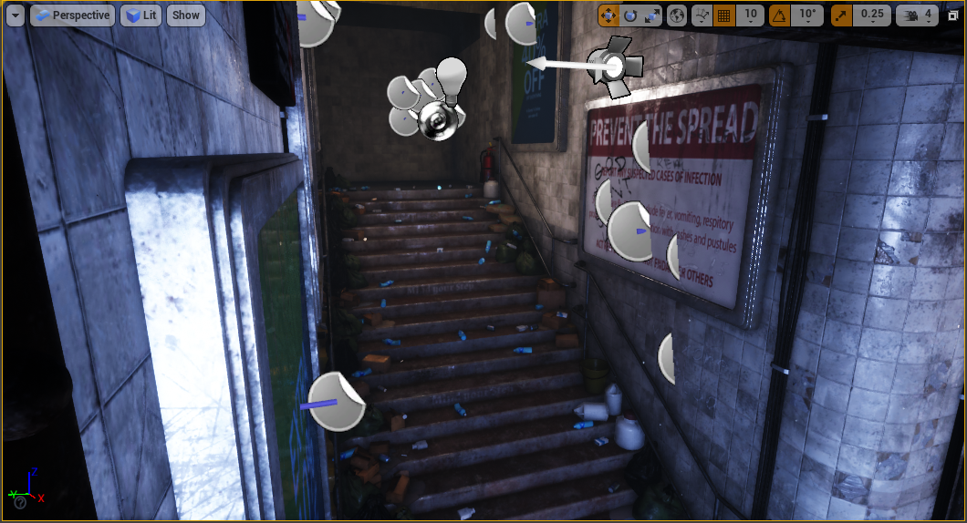
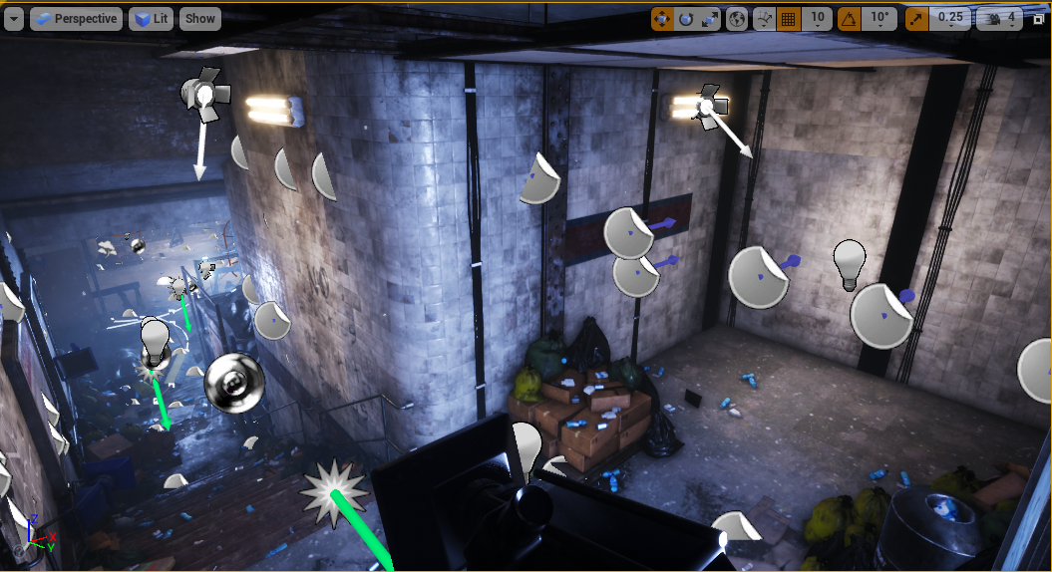
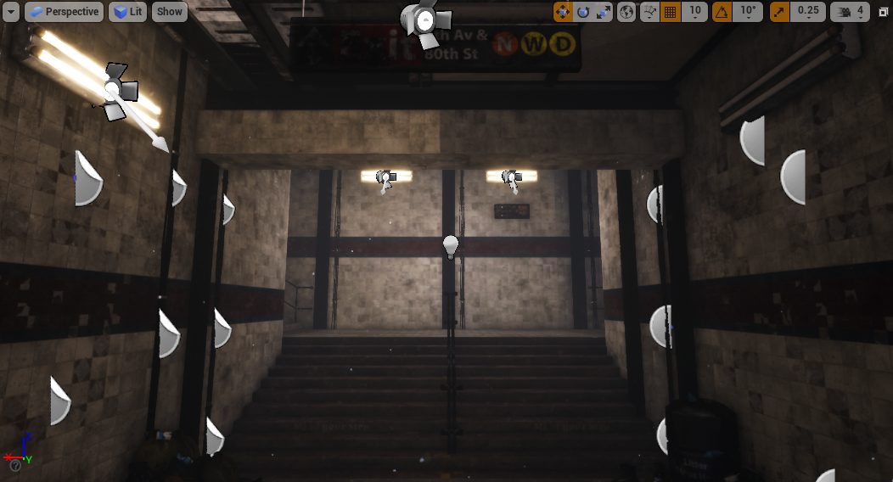
Train Station Level (Extensions made)

Slide 18
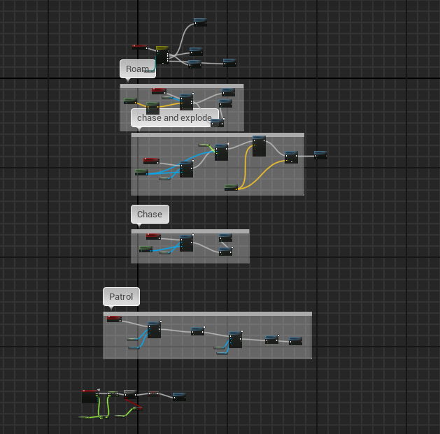
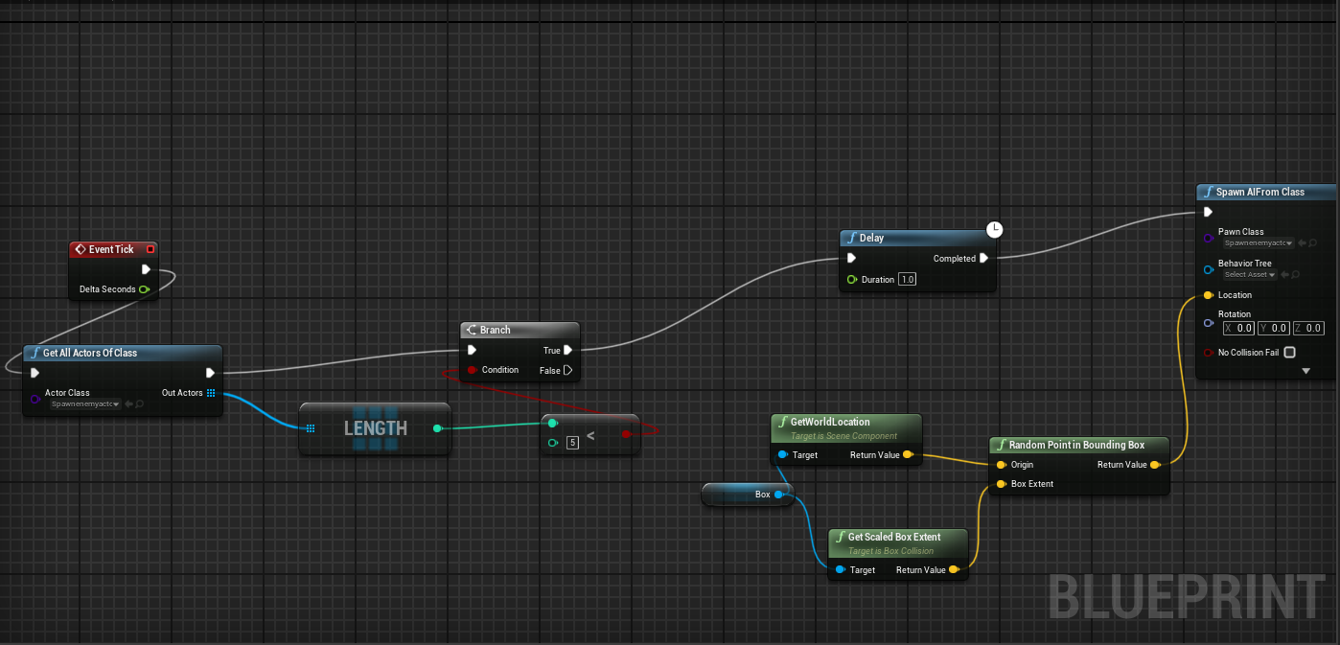
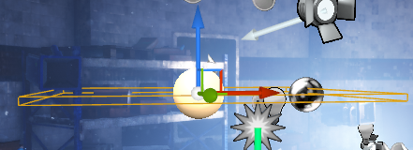
Horde system & Spawner and enemies

Slide 19
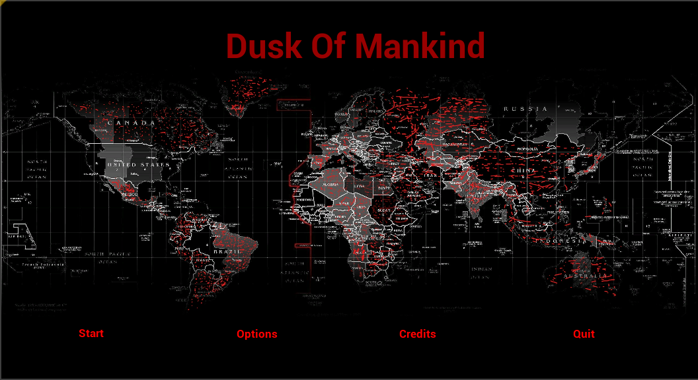
Start Menu

Slide 20
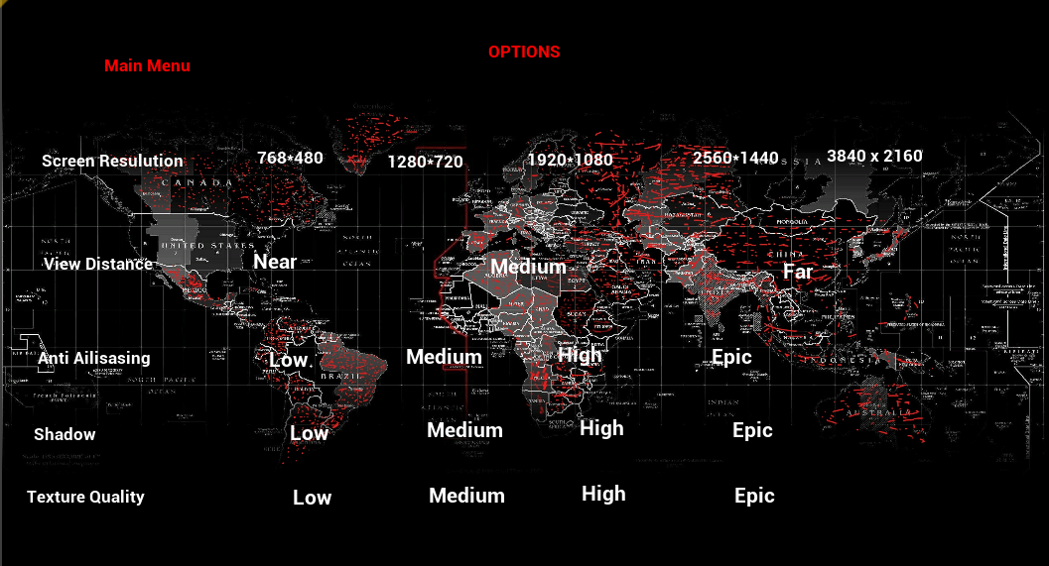
Options Menu

Slide 21
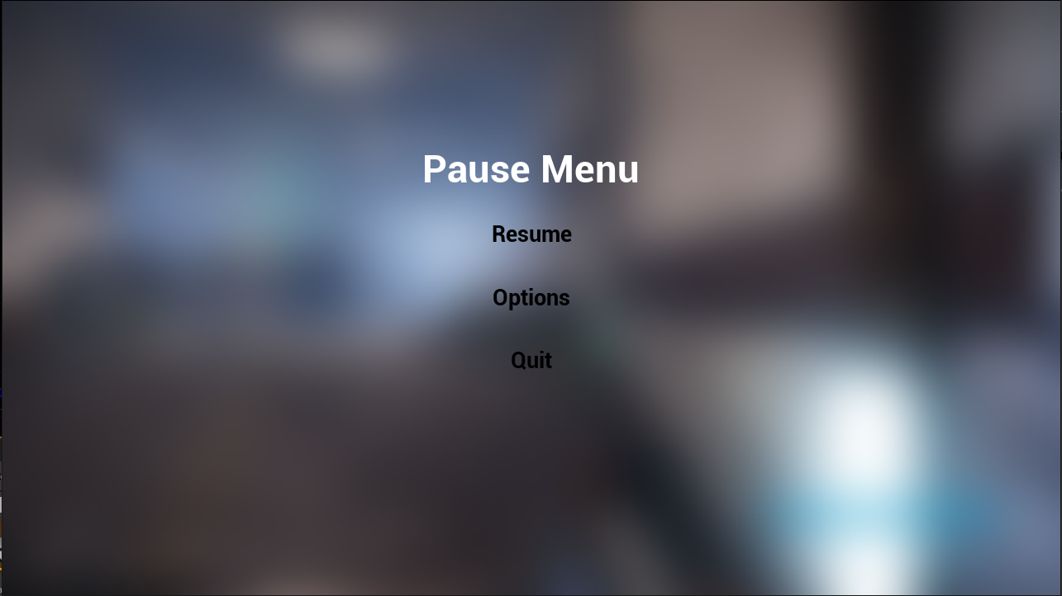
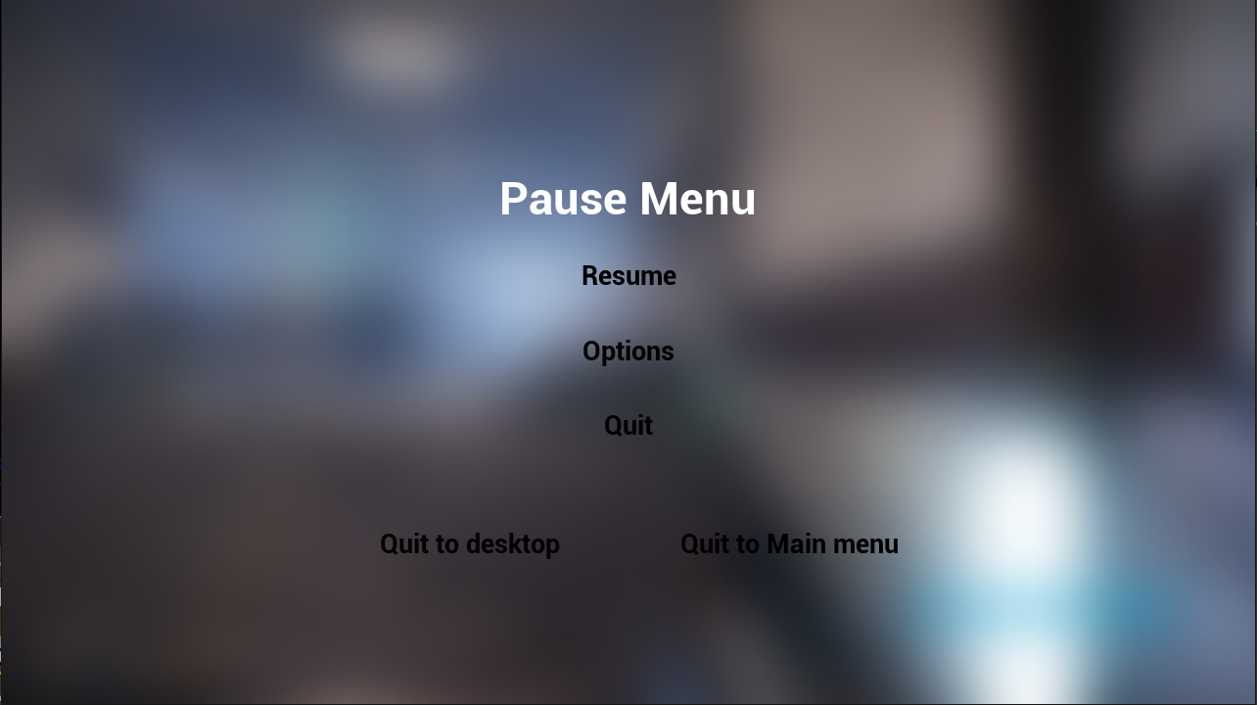
Pause Menu & Quit Menu From Pause menu

Slide 22
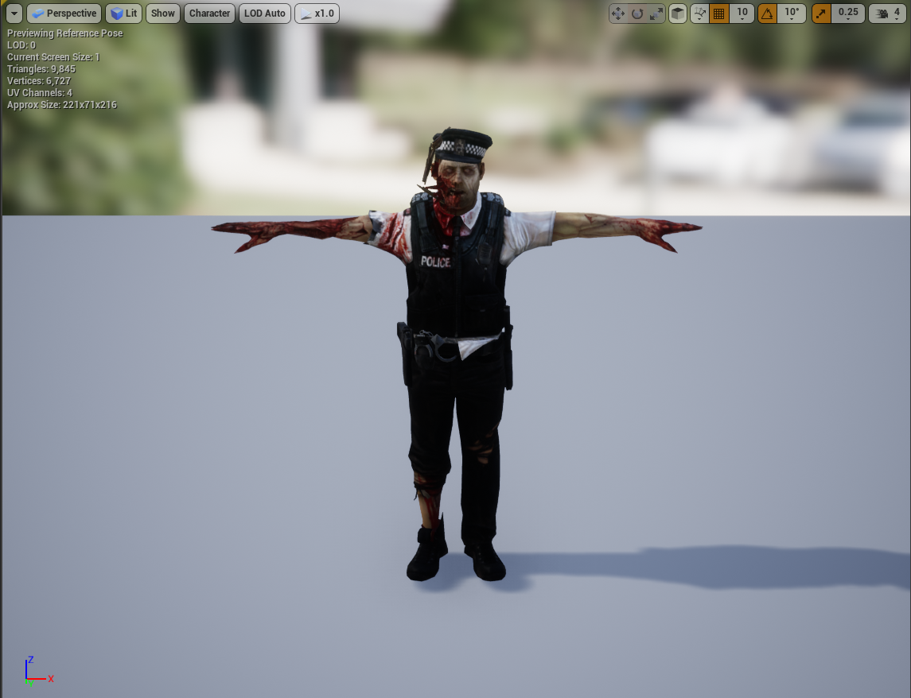
Horde enemy Skeletal Mesh For Train Station Map

Slide 23
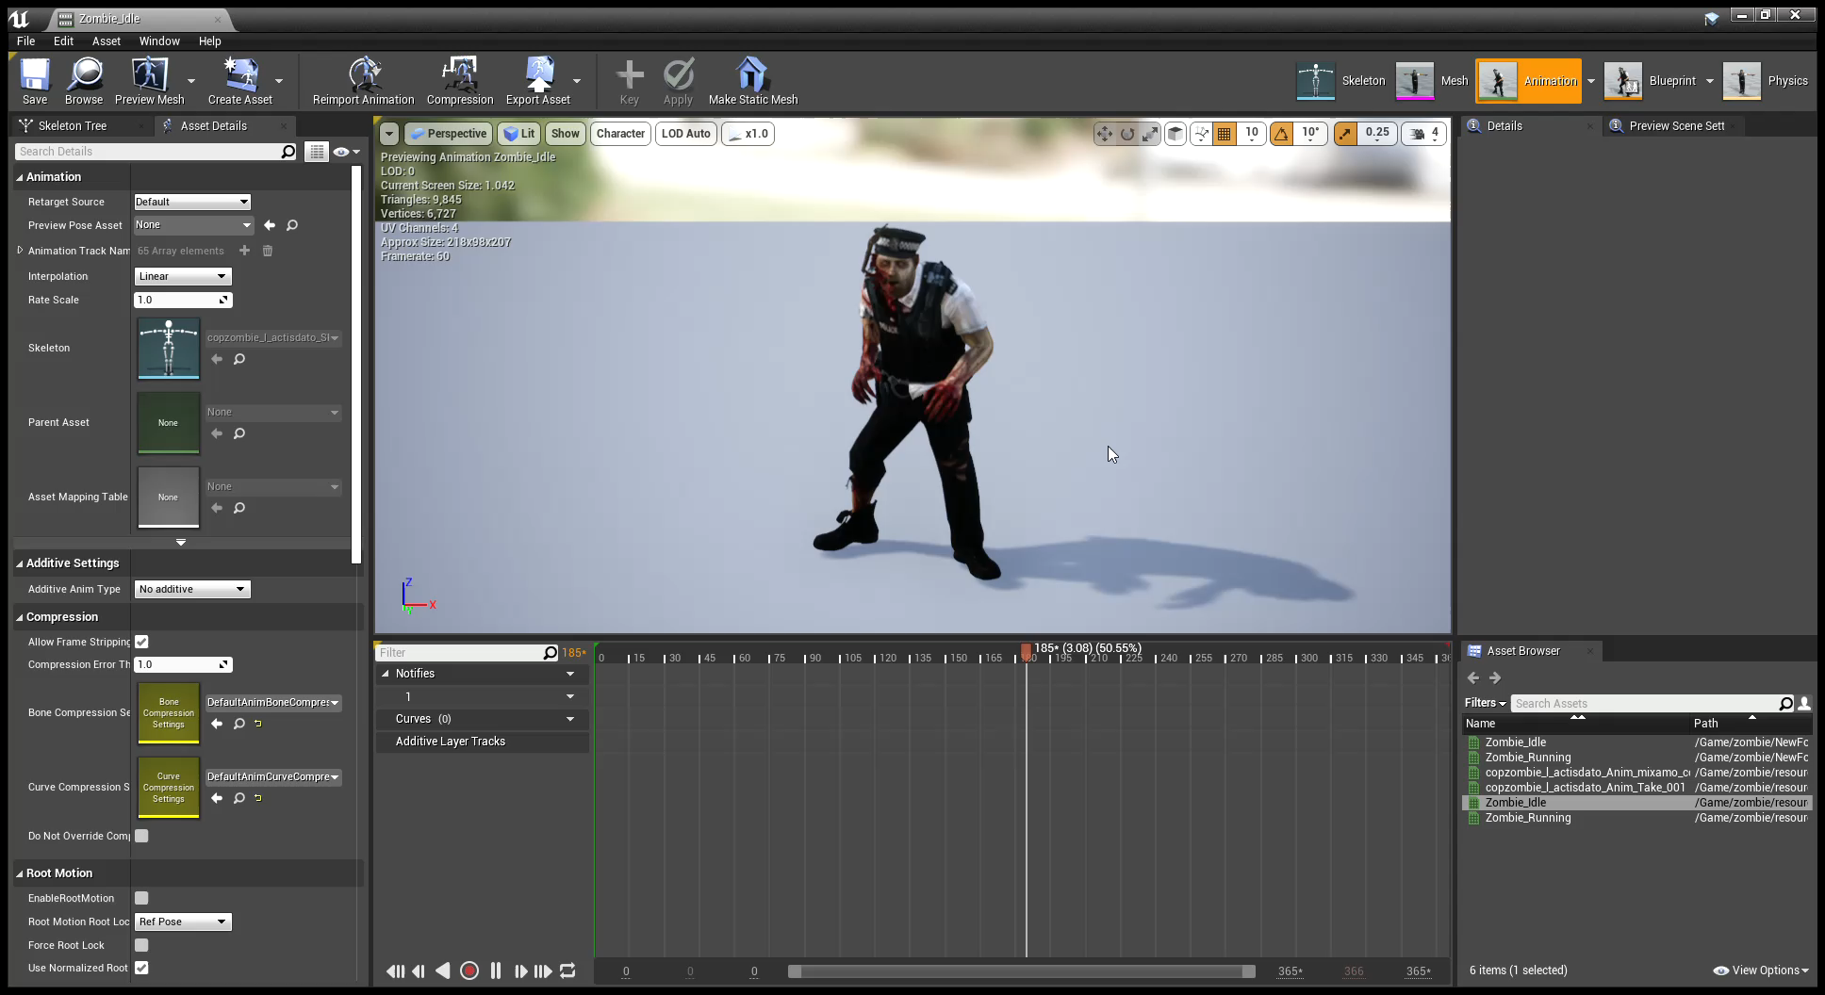
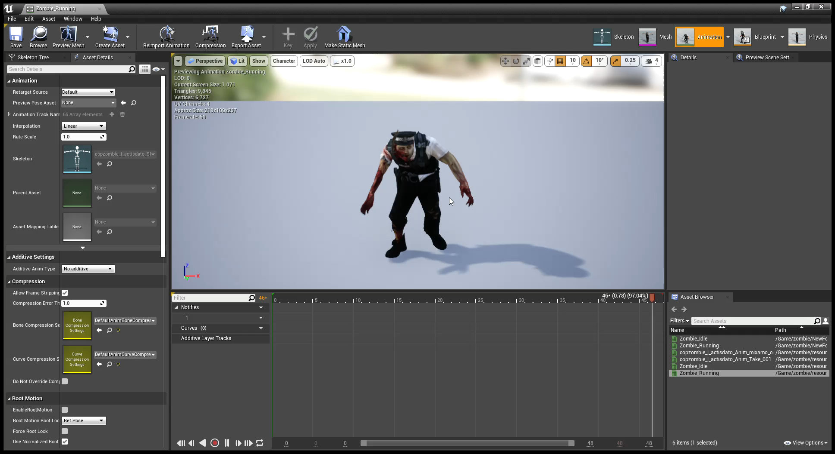
Animations for train Station Enemy

Slide 24
ACTION PLAN
Work Done
First Map
Enemy AI
Gun Models
Story
Back
story
Shoot
ing
HUD
Wave system
Enemy damage
Player damage
Protagonist character
Start screen
Death screen
Enemy Placement for The First Map
Bullet tracers impact, hit sound, muzzle flash
Enemy Animation
Options Menu
Wave Spawner
Work due
Scoring
System
2nd map
3rd map
Cut scenes
Start screen
Enemy Placement
(cant progress until map completion)
Leader board System

Slide 25
Thank You

